Slide 1
Research
By Yash DT, Jay Yeung, Timothy Hu, Khaled Zaza, Joshua Stasior, and Waseim Helweh under the guidance of mentor and SJSU professor Dr. Robert Chun

Slide 2
Abstract:
With the growth of the recent pandemic in tandem with the development of online learning, it has become more accessible for classes and lectures to be conducted to larger audiences without the spatial limitations of traditional lecture halls or classrooms. Even with the transition back to physical classrooms, class sizes have continued to steadily increase, and along with them, changes in potential success factors. Potential success factors, which include GPA, student retention, and job acquisitions, have begun to alter over time with growing changes to classroom sizes. Via analysis of various aggregated data sources from San Jose State University, we have begun to find evidence that can be used to analyze the relationship between class size and these success factors. At this point, our research has only scratched the surface in uncovering future and other success factors that potentially correlate with growing lecture halls and classrooms.

Slide 3
Introduction
Following the COVID-19 pandemic, the Computer Science department at San Jose State University has seen an influx of new students enrolling in the department’s classes. In conjunction with the rising student population at San Jose State University as a whole, this influx has led the university’s administration to significantly increase class sizes in the Computer Science department. We hypothesize that because of the decreased student-faculty interaction, decreased adoption of innovative teaching techniques, and a decrease of various other procedures instrumental to student learning as a result of larger class sizes (Timothy Diette and Manu Raghav, 2019), increased class sizes has led to an overall decreased quality of education in the San Jose State University Computer Science department.

Slide 4
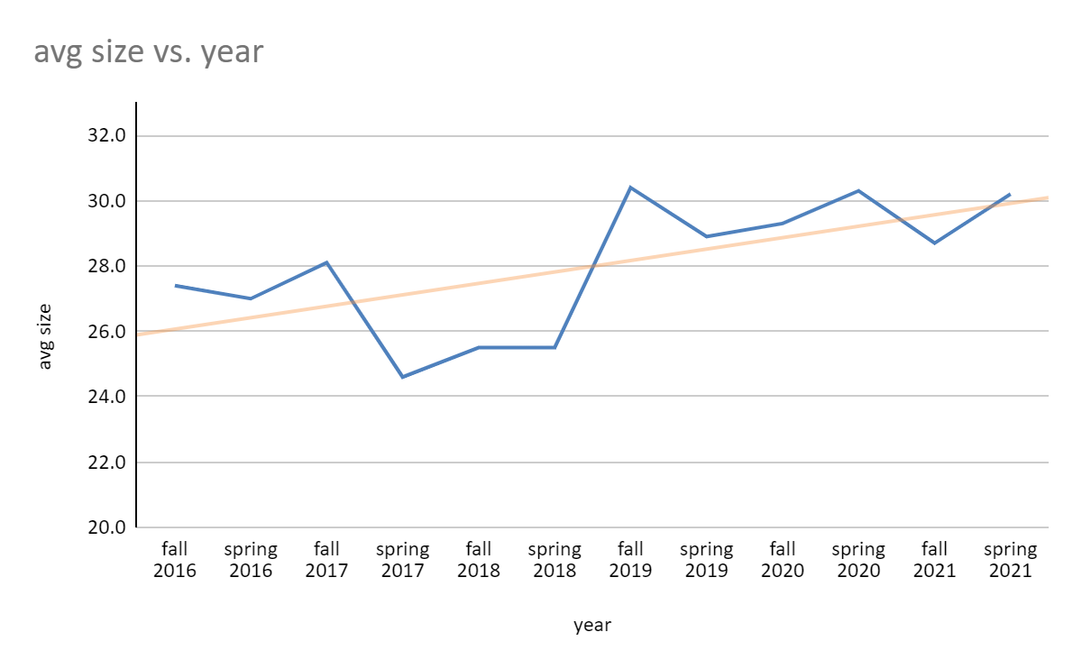
Data Analysis - Recent Trends - Class Size

Slide 5
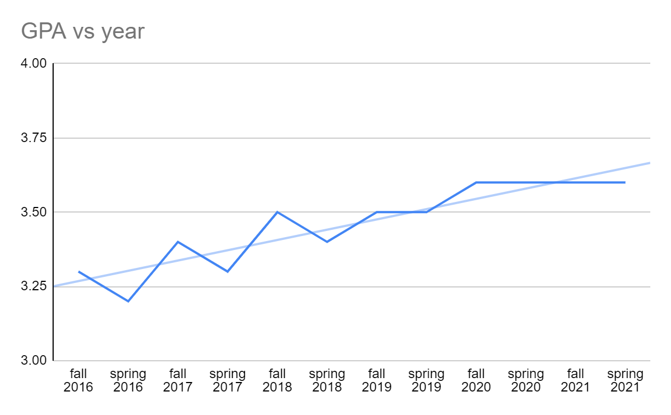
Data Analysis - Recent Trends - GPA
Although GPA trends are going up, this could be a result of easier online classes, easier grading in general (grade inflation)
We are still in the process of investigating the differences between in person and online classes and how big a role grade inflation plays into the school GPA
Grade inflation is the awarding of higher grades than students deserve, which yields a higher average grade given to students. The term is also used to describe the tendency to award progressively higher academic grades for work that would have received lower grades in the past.

Slide 6
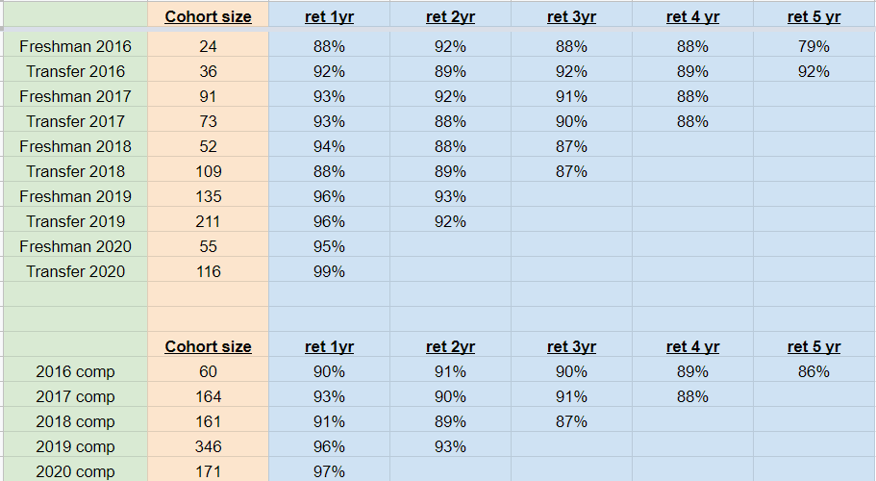
Data Analysis - Retention Rates

Slide 7


Future Plans for research
We would like to extend our research to not only analyze San Jose State University's data but to analyze data from multiple colleges and eventually even national data This would allow for more general trends to be found, which could help us in determining factors to better education, on a much larger scale.
We plan to do this by leveraging data from other colleges, such as CSU’s, and eventually the NSCG (National Survey of College Graduates) data, to see if we can plot trends that relate increasing class sizes with other factors, such as job satisfaction etc.
We would also like to compare the students GPA with the previous years, to see if we can see a trend between online classes and average GPA. We plan to wait until we don’t have as many online courses as currently. We think that online testing may not show the real understanding that the student has of the topics.
Notes:
Link to the NSCG website: https://www.census.gov/programs-surveys/nscg.html

Slide 8
Conclusion
Our team initially hypothesized that larger classroom sizes were detrimental to student success and overall quality of education with regards to Computer Science at SJSU. Through the course of our research this summer, we encountered problems gathering and gaining access to various data that was needed to further filter our analysis and produce more tangible results. In our analysis of the data we did have access to, however, due to grade inflation in addition to an increase of online courses following the pandemic, analyzing grade point averages and retention rates chronologically was mostly unable to support our hypothesis despite the large influx of students and gradual increase of class sizes in the recent years. As discussed in the previous slide, we have plans to address these obstacles in further research and believe that we have set a strong foundation for future researchers contributing to this project.

Slide 9
References
https://analytics.sjsu.edu/
https://www.jstor.org/stable/24693708

